Slide 1
CoArch: Supporting Human/LLM Interaction in Building Complex Artifacts
Peli de Halleux, Michał Moskal, Ben Zorn September 2023
CoArch is short for “co-architect” to highlight its role in coordination and design
Notes:
CoArch is a synchronization tool that streamlines documentation within software projects. It partitions documents into "fragments" which share common identifiers, thereby creating links. Users can employ either built-in or user-defined semantic macros, which then generate prompts for a Large Language Model (LLM) using these fragments and their respective links. The responses from the LLM are then used to update or create new fragments, ensuring that the documentation remains consistent and current.

Slide 2
Complex Artifacts Require Complex Processes
modern software repositories require complex processes and dependence hierarchies
Input file: test.text
stdio.h
root
sort
a.c
c.c
b.c
docs
src
modules
uniq
cc
spec
tests
wc
a.o
b.o
c.o
Output: 55
ld
cc
automated processes
a.out
testgen
linear generation (pipes, chat sessions)
tree hierarchies (makefiles)
code review
human processes
bug triage
How can AI best support these complex processes?
Notes:
Emphasize not just generation but: review, consistency checking, exploration, etc. Also emphasize this isn’t just about software – any field that has collections of related artifacts can benefit

Slide 3
Working with AI Beyond Chat Interfaces
Chat interfaces are powerful
ChatGPT instant success
Bing Chat
Many instances of M365 Copilots
But…
Chat is a “bolt-on” side panel experience
Chat doesn’t scale – lack of modularity, abstraction, reuse, etc.
Chat doesn’t envision new AI use scenarios

Slide 4
CoArch: Supporting Human/LLM Interaction in Building/Maintaining Complex Artifacts
CoArch is a programming language framework and UI to support human/AI collaboration
CoArch goals
Support creation, evolution, and maintenance of complex artifacts, including ensuring consistency across components
Enable new human/AI interactions and experiences
First-class support for human/AI collaboration
Promote CoArch prompts as a highly-tuned, first-class SW artifact: can be edited, reviewed, shared, etc., by a team with a wide ranges of skills
Notes:
Talk about limitations of chat (in relation to CoArch)

Slide 5
AI Requires New Tools and Experiences
Technology trends inspire new languages and tools
GUI applications: C++, Web applications: JavaScript , Foundation models: TBD
New scenarios
Creation of multiple, related documents simultaneously
End users creating new tools/utilities for diverse use cases
AI-support design complex artifact design
Existing experiences and tools don’t account new scenarios

Slide 6
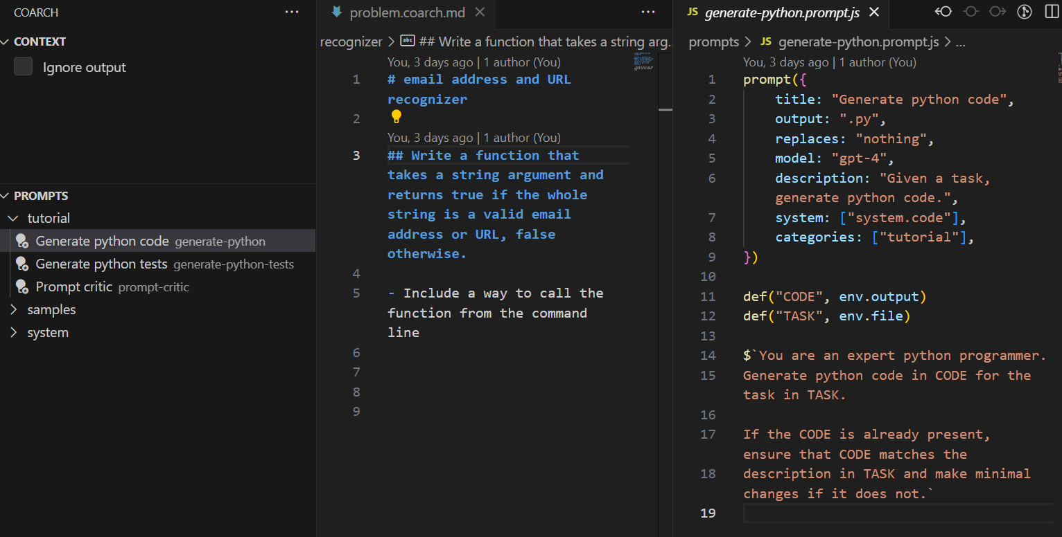
CoArch at a Glance
CoArch is a language framework integrated into VS Code to support human/AI collaboration
Command files (in markdown) describe specific user task
Prompt files leverage LLMs to provide reusable tool capabilities
Collections of related prompts support diverse workflows
User applies prompt file to .coarch.md file to generate LLM result
Notes:
CoArch includes
CoArch commands: markdown files .coarch.md
CoArch prompts: prompt files

Slide 7
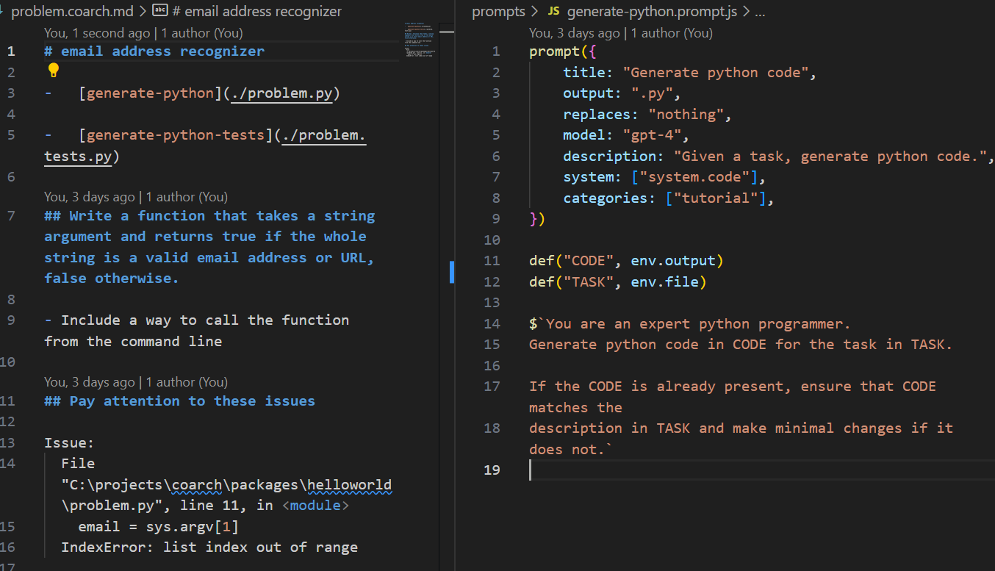
Demo 1 – Hello World
Generic .prompt.js implements task: writing Python code
User writes markdown to solve a specific problem that in combination with prompt creates an LLM request.
Context provided in prompt via “env” references to related user files
Prompts combine freeform text with integrated JavaScript
Links provide references to other data sources
Two files, the .coarch.md and the .prompt.js file, combine to create the request to the LLM

Slide 8
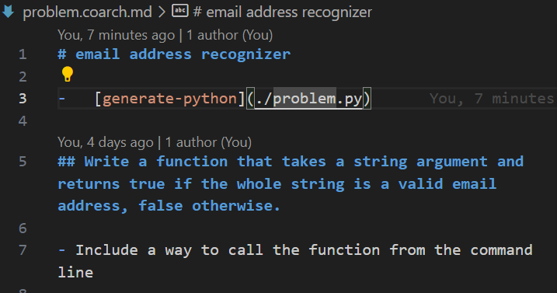
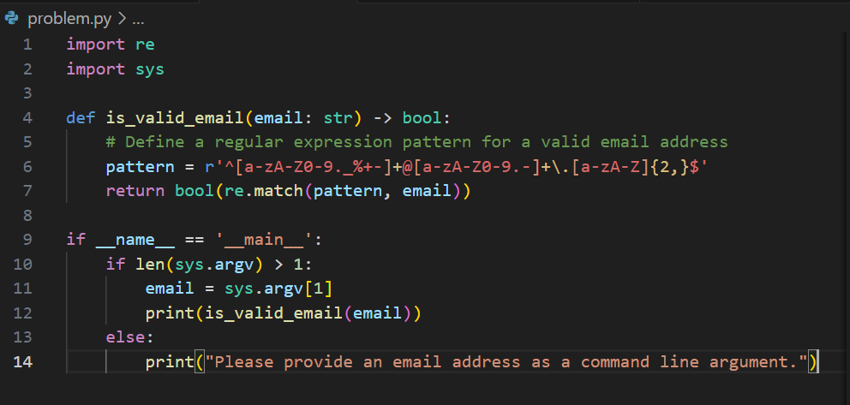
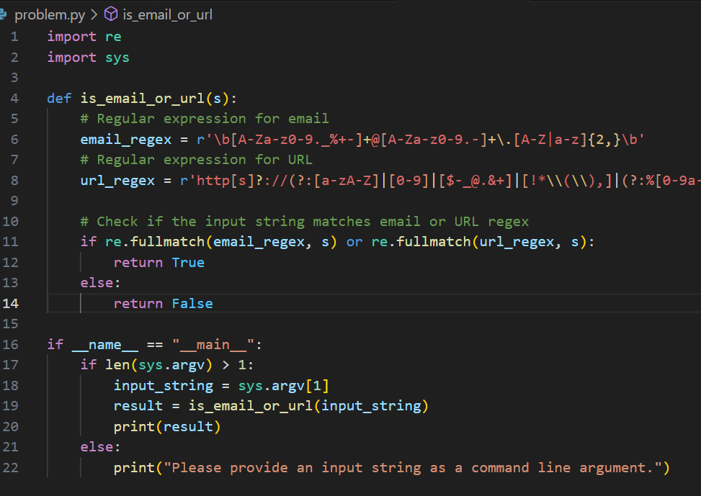
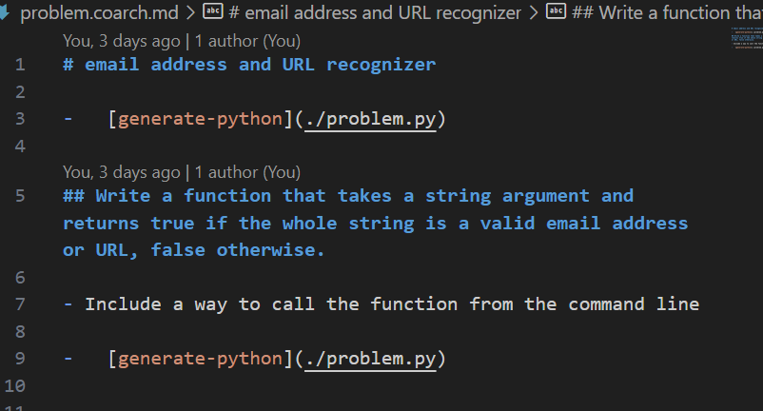
CoArch Interaction Process
Describe codegen task
Apply codegen prompt
Update
codegen task
Apply codegen prompt

Slide 9
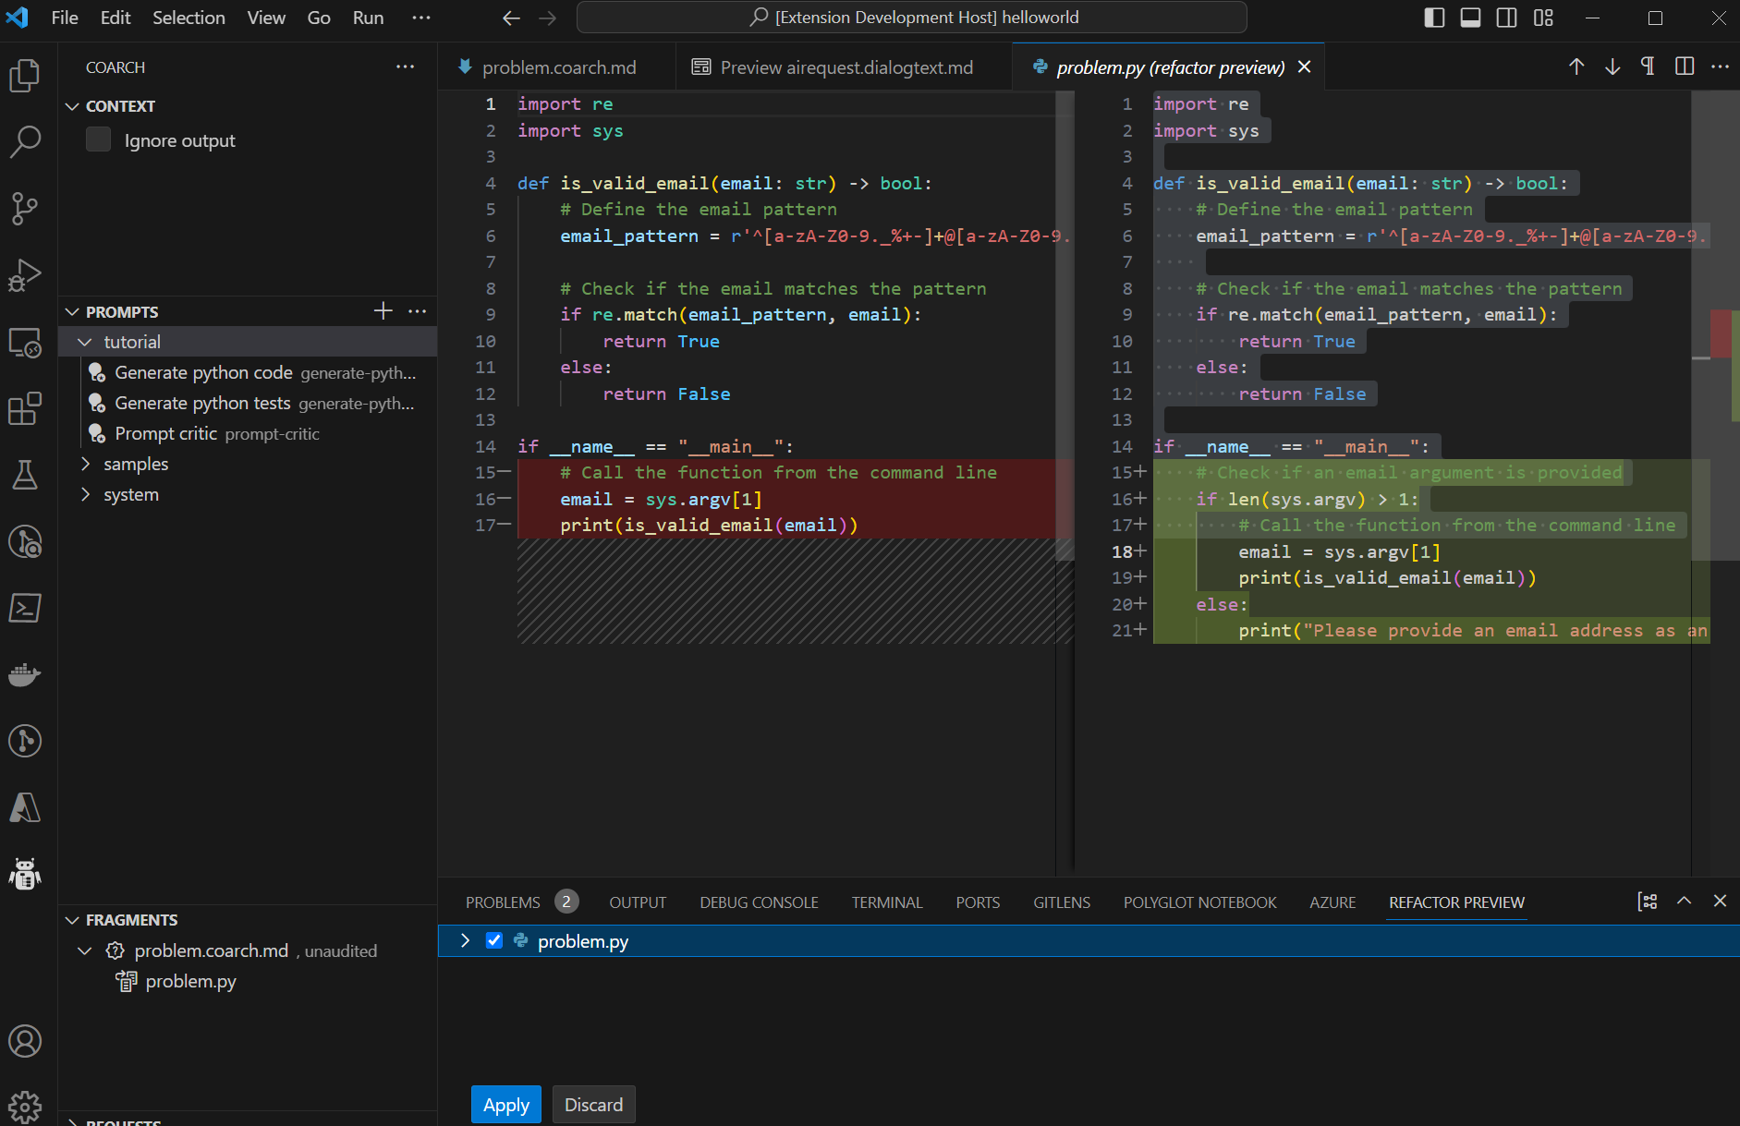
Refactor View Supports Human/AI Coordination
Original code did not correctly handle being called with no arguments
New code fixes this issue
This example illustrates how updating the CoArch command file with additional information leads to changes in the generated code that can be previewed in VS Code

Slide 10
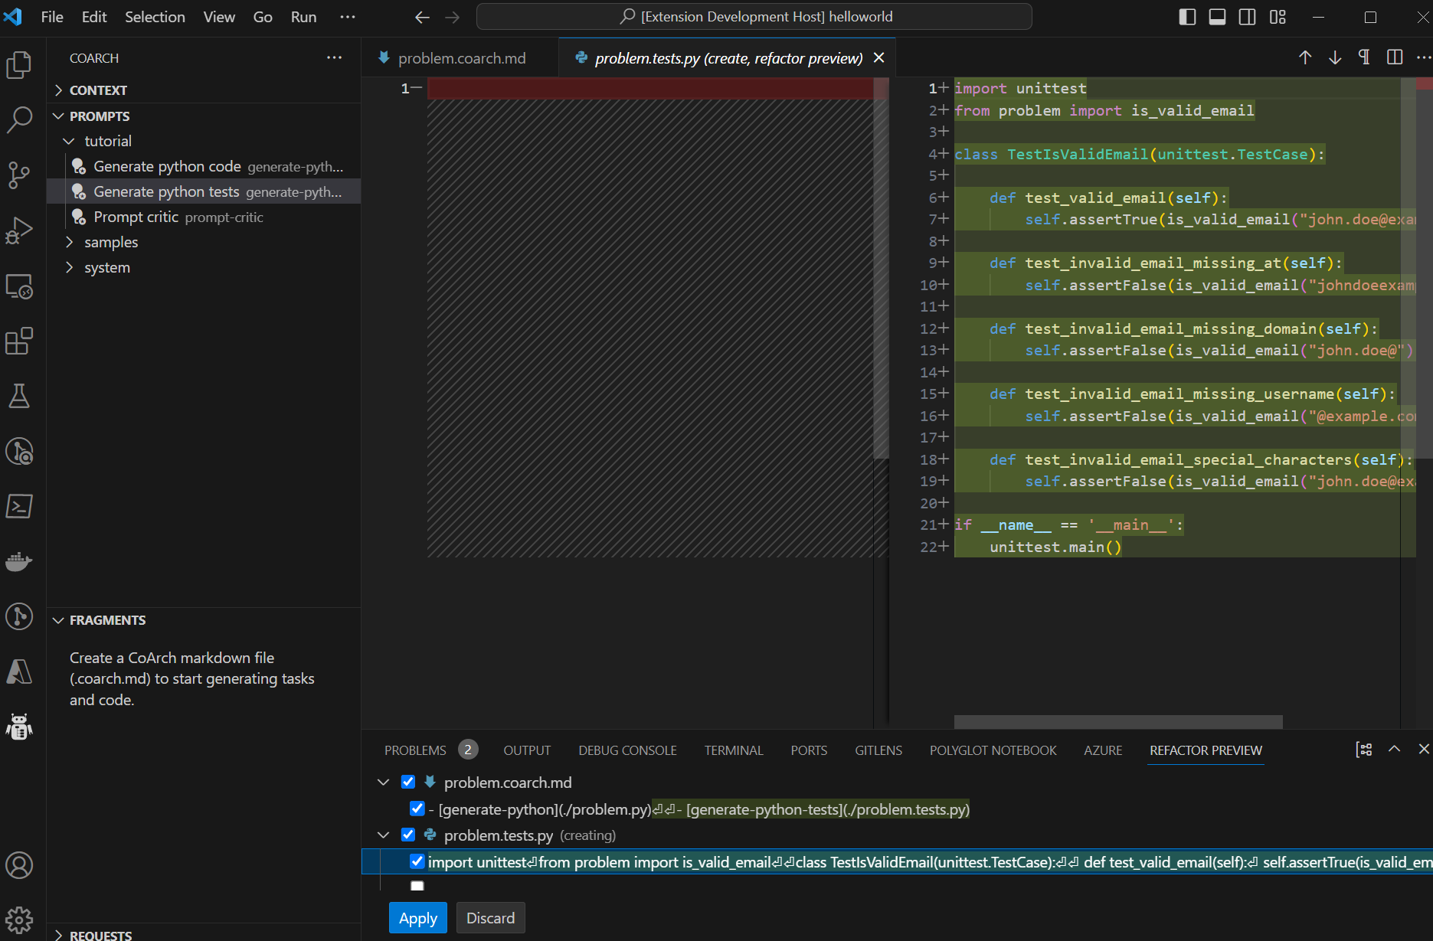
Coordinating Prompts Example: Generating Unit Tests
Applying a new prompt to the original file + the python code previously generated, we can now generate unit tests for the previously generated code

Slide 11
CoArch Supports Hierarchical Decomposition
CoArch Example: Document Writing
CoArch .md file with paper abstract
Leverages LLMs capability to decompose tasks into subtasks
Builds refinement tree and allows prompts to operate on it
Supports editing content and/or prompts at any node of the tree
Prompts can be highly engineered but also customized for a specific team or application
Decompose Prompt
Intro
Related Work
Evaluation
Elaborate Prompt
Full Intro
Full Related
Full
Eval
Critic Prompt
Critical Analysis

Slide 12
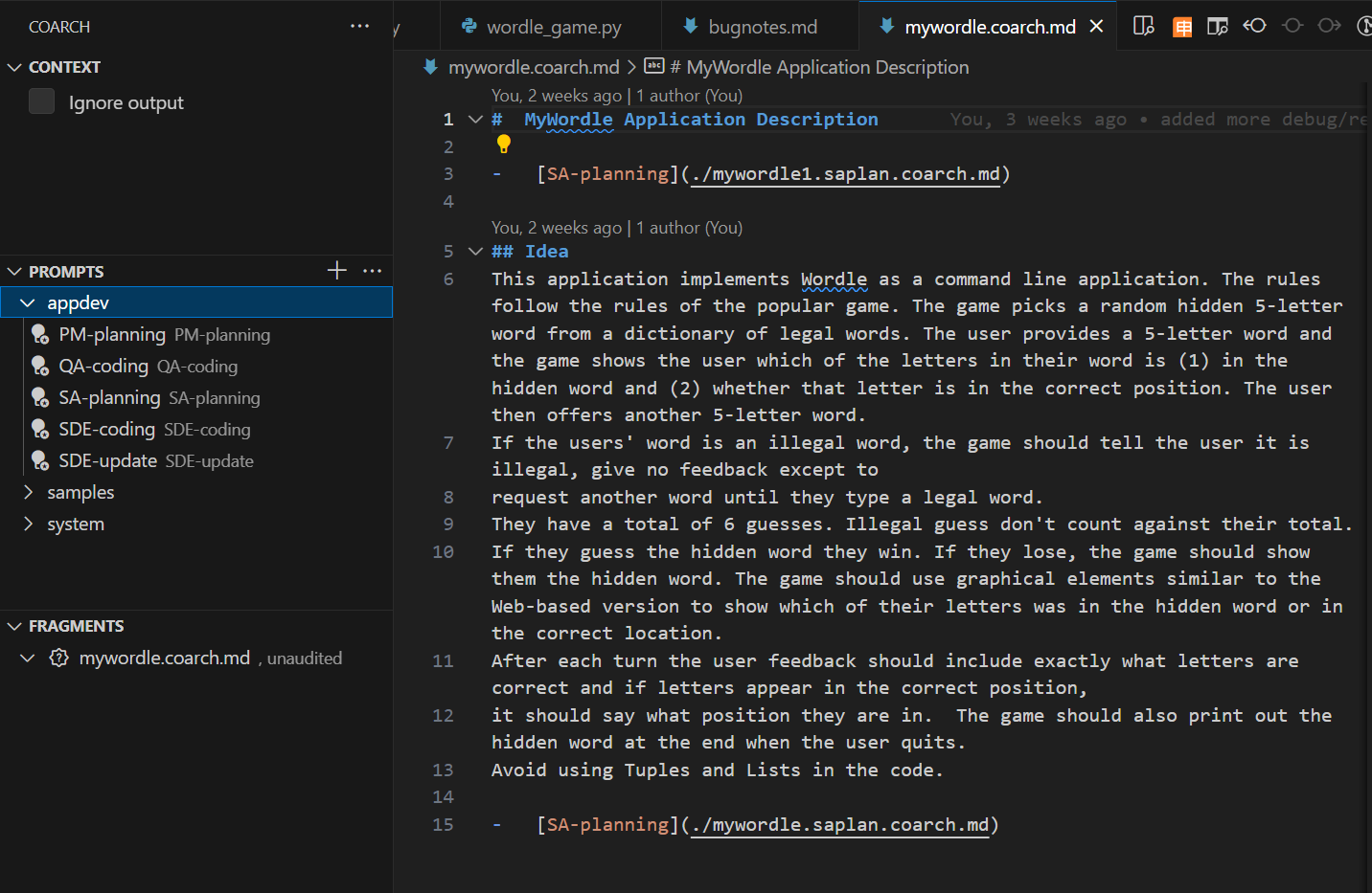
Demo 2 – mywordle - Prompts as Roles
Goal: write Wordle app
Process: describe app at high level in mywordle.coarch.md
Define different roles as prompts to apply to mywordle.coarch.md Roles: system architect, SDE, QA, documentation, etc.

Slide 13
Key Properties of CoArch
Abstraction
Clean separation of tools (prompts) from application for reuse
Commands in markdown direct application of prompts
Explicit Dependences and Workflow
Maintains dependence tree identifying what content was generated from what command + prompt
Sources represented explicitly in prompts
Sequence of prompt applications similar to Unix pipe (except human in the loop)
Allow for LLM failures
Support human-editable LLM outputs
Support human oversight, review, and maintenance
Ease of authoring and customizing prompts for particular task

Slide 14
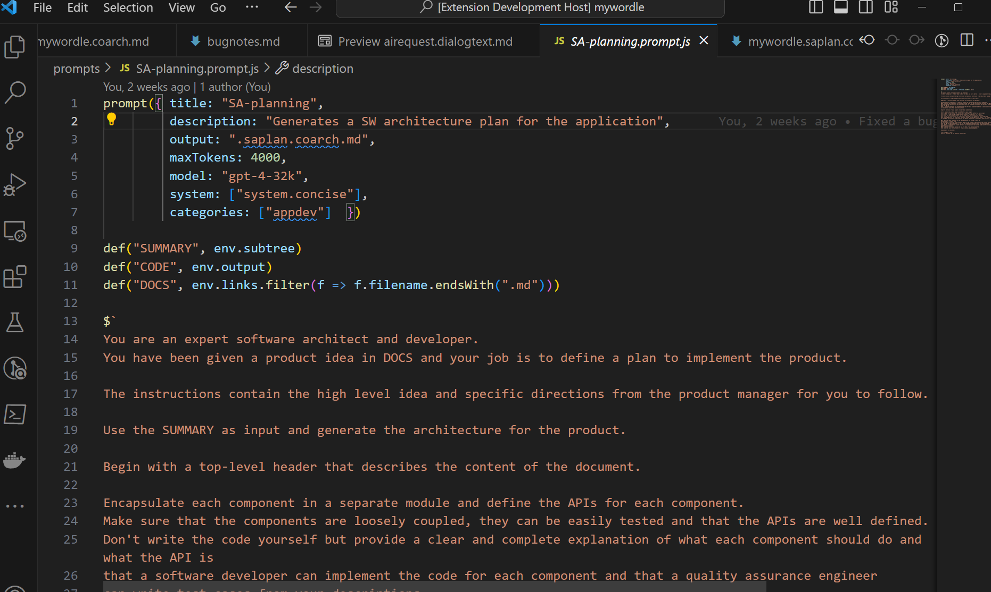
Demo 2 – mywordle – System Architect
System architect prompt decomposes problem into files, APIs, etc.
Writing effective prompts is like writing software, requires expertise and effort
CoArch supports users with different skills to customize in different ways

Slide 15
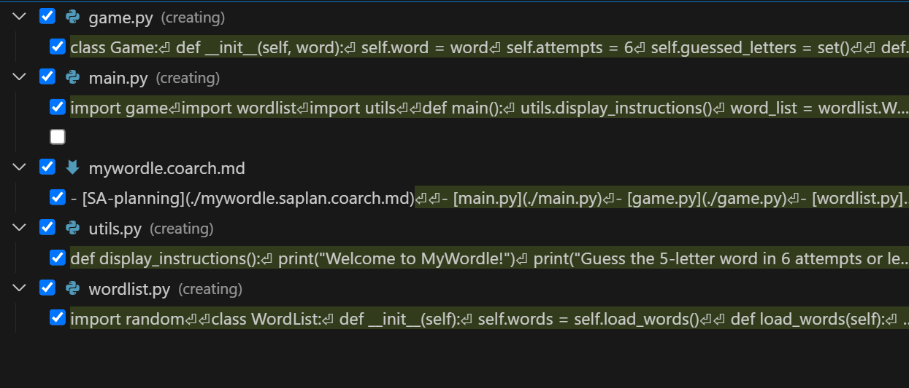
Demo 2 – mywordle – Developer Prompt
SDE prompt generates multiple Python files based on the architect’s specification

Slide 16
Research Challenges
Defining abstraction boundary with prompts
What to hide from user, what to expose?
Example: Does the user specify the LLM to use (like “register” decl in C)?
Optimizing LLM use at the CoArch prompt level is a new research area
Example: Determining how to fit the most important and necessary context into the window
Supporting bidirectional consistency automatically
Example: edit either problem description or code, have the other automatically updated for consistency
How? User writes reverse prompt? Automatically generate?
How do we define “consistent enough”?
Can we achieve acceptable levels of consistency with model nondeterminism?
Exploring classes of experiences CoArch can support

Slide 17
Discussion
CoArch is a general-purpose framework for defining, connecting, and applying related prompts
What are good examples of verticals that benefit from this?
Given CoArch framework, what are good collections of related prompts?
General purpose (such as review, check for consistency, etc.)
Vertical specific (what verticals)?
How can we leverage CoArch to support important responsible AI properties (privacy, security, etc.)

Slide 18
Bigger Picture: MSR AI Inference Stack
Collaboration across MSR, Azure HPC, AI Platform, Azure ML
Guided Prompt Constructor
CoArch:
Consistent Hierarchical-prompting
Constraint Generators
Text Prompt
Memory & Content Retrieval
Disciplined abstractions to enable
cross-layer optimizations while ensuring
modularity, programmability, and portability
Plugins
Guidance VM
Inference Scheduling
AI Frameworks
(PyTorch, ONNX)
KV cache mgmt
Phi-X
Phi-X
Phi-X
Batch scheduler
Phi-X
Phi-X
LLaMa-X
Task Orchestration
…
Phi-X
Phi-X
Compute/Communication Ops
GPT-X
MSCCL++
Fine-grained Comm
cuSync:
Fine-grained
Kernel Sync.
NCCL
CUDA kernels
Model Abstraction Layer (MAL)
Hardware Abstraction Layer (HAL)
NVIDIA GPUs
NVLinks/IB/..
Microkernels
MMA
Comm verbs
NVIDIA GPUs
NVLinks/IB/..
AMD GPUs
XGMI/IB/..
Athena/Bragha
OCS/TrueFabric

Slide 19
Bigger Picture: FAST Project: The Full AI Stack Rethinking the Inference-Time Platform
Every disruptive technology requires rethinking the platform
…, PC, Internet, Cloud, Mobile
Driving trends:
Users want higher-level macro-tasks
→ Many stakeholders must coordinate
Monolithic LLMs challenge separation of concerns and have fundamental limits
Weakest stakeholder breaks security, safety, and other RAI concerns
We have to design for AI failures
Limited by GPU performance and avail.
→ Co-design and optimization across stack
Secure, Safe, and Responsible LLM apps Improve benchmarks and online metrics
CoArch Consistency and synchronization across macro-tasks w/ many prompts
Libraries:
Numerics, …
Orchestrators and Agents
Semantic Kernel, Langchain, MetaGPT, …
Core Guidance
Single prompt guided decoding
On-device LLMs
Constraint providers
Enforce hard and soft spec
Cloud Guidance
Secure execution and low-level acceleration
­Hosted LLMs
Notes:
Users want higher-level macro tasks -→ this is a strong contrast to recent trends in mobile apps
Monolithic LLMs, where all functional concerns are managed through prompting and finetuning puts too much pressure on every stakeholder to build their AI component perfectly.
We must design assuming failure; and separate the complexity and hardest problems into dedicated infrastructure that will enforce correctness even when others fail.
We must also do this while preserving the flexibility that LLMs provide
GPU efficiency and availability must be paramount. This means that the most expensive tasks across the stack must be co-designed with low-level optimizations.

Slide 20
Next Steps
Get more experience with CoArch, engage with initial users
Explore approaches to ensuring consistency of related content
Consider additional automation (e.g., rerun sequence of prompts, batch automation of consistency checking)
Explore integration into experiences beyond VS code (e.g., Office)

Slide 21
Related Documents
CoArch repo: microsoft/coarch: CoArch - Refinement Copilot (github.com)
CoArch - Trusted Natural Language Software Development May 2023.docx
Problems with Chat AI Interfaces June 2023.docx

Slide 22
Backup

Slide 23
How Does CoArch Relate to…?
Guidance – Guidance defines a language for a single prompt and CoArch defines a way to connect a set of related prompts and task descriptions
Similarly, TypeChat addresses controlling input/output with a single prompt
Semantic Kernel – SK defines skills (functions implemented as LLM calls), which relate to CoArch prompts, but does not define a user experience to coordinate them or enable scenarios where non-professonial developers can benefit from them
Similarly for langchain
Flux/Sydney – Orchestrators support scenarios with multiple SW/LLM interactions but don’t expose the coordinate of the interaction directy to a user for oversight/input
These runtimes are intended to be used to build LLM-enabled applications but not to support creating a wide ecosystem of users that contribute prompts

Slide 24
Goal: Build a complex artifact (doc, repo, etc) Problem: Chat Interfaces are Inappropriate
Chat is linear and does not scale
No hierarchical decomposition
Train of consciousness structure
Difficult to share, lacks modularity and abstraction
Not integrated into the artifact it is used to create
What does an alternative look like? Some requirements:
Description of the entities involved (presumably at least the user, Copilot, the LLM, and the artifact)
Elements that express human intent
Descriptions of tasks that the Copilot can do to aid the user (via prompts)
Recursive, hierarchical structure
For more details, see: Problems with Chat AI Interfaces June 2023.docx

Slide 25
New Features and Generizations
Prompts are currently implemented via LLM, but could be arbitrary scripts
Prompt language is currently text + some JavaScript substitution
Could benefit from more sophisticated language like Guidance
Need more expressive way to identify and input context and sources (files, URLs, search results, DB, etc.) for RAG
Need summarization capabilities to match size of context input with LLM window size

